Slide 1
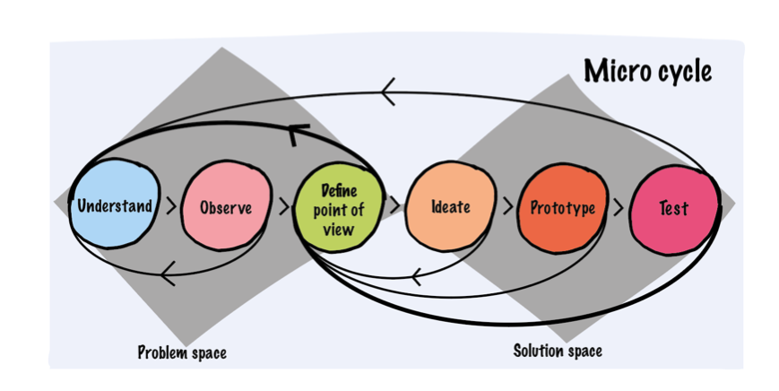
Poster title
Student: First name, Last name
1. Introduction, Goals, Research Questions
3. Results and Discussion
Use arial 12 for the boxes and arial 16 for the titles.
You can extend or decrease the boxes vertically depending on your content.
Describe the situation on which the project is based, in factual, neutral way, ideally with some information about size, quantity, quality.
Describe the problem at hand, the solution sought in a concise manner.
Ideally highlighting the relevance/criticality of the study.
During the results provide graphs, tables to describe the outcome of your study in a structured, logically flowing way, as applicable for your project.
In the discussion provide your reflections on your methodology and the results with emphasis on quality and relevance.
2. Method Overview and Materials
Figure: Example chart
General Information
Make your scientific poster easy to follow for anyone, even if they're not an expert in your field. Arrange it logically, use headings and colors, and get feedback from a colleague. Begin with a clear objective, then dive into experiments or research methods, highlighting results in the main part. Spice it up with big photos, figures, tables, and avoid attaching tiny typewritten sheets that no one can read from a distance.
In a scientific poster, the "Methods and Materials" section is like the behind-the-scenes scoop on how the magic happens. It spills the beans on the tools and ingredients used in the experiment. It's where you share the secret recipe for your scientific success!
Method Overview
List of used scientific methods & tools, ideally in flow chart, for instance literature research, interviews, survey, analysis of some type, comparison, evaluations, etc.
Materials, Data, Tools
List and briefly describe any specifically (practice partner) data, materials, samples, tools as used in the project / study
4. Conclusion and Recommendations
The conclusion should recap the main results, address research objectives, discuss implications and significance, acknowledge limitations, suggest future research directions, and employ visual elements for clarity, all presented in a concise manner.
Figure: Examples
References
Insert the 1-3 most relevant references in APA style, for instance like:
Smith, J. R., & Johnson, M. K. (2020). The impact of climate change on biodiversity. *Environmental Science and Technology, 25*(4), 123-145. doi:10.1234/example
Industry Partner
Supervisor: First Name, Last Name
Expert: First Name, Last Name
Semester: Autumn / Spring Semester, Year
Notes:
If it is ok for confindentiallity

